Slide 1
Embedded Methods Feature Importance from Random Forest
Nov 14 2025
Giảng viên: TS. Lưu Phúc Lợi
Luu.p.loi@googlemail.com
Zalo: 0901802182

Slide 2
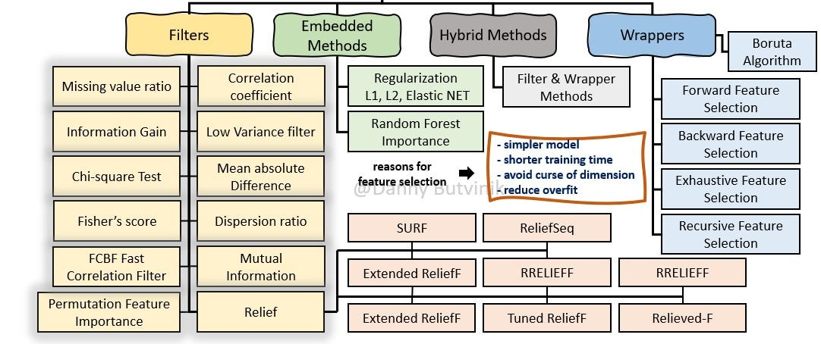
https://medium.com/analytics-vidhya/feature-selection-extended-overview-b58f1d524c1c

Slide 3
Content
What is cross entropy and conditional entropy?
What is Information Gain?
Decision Tree
Bagging
Boosting
Random Forest
Feature Importance from Random Forest
Hands-on Exercises

Slide 4
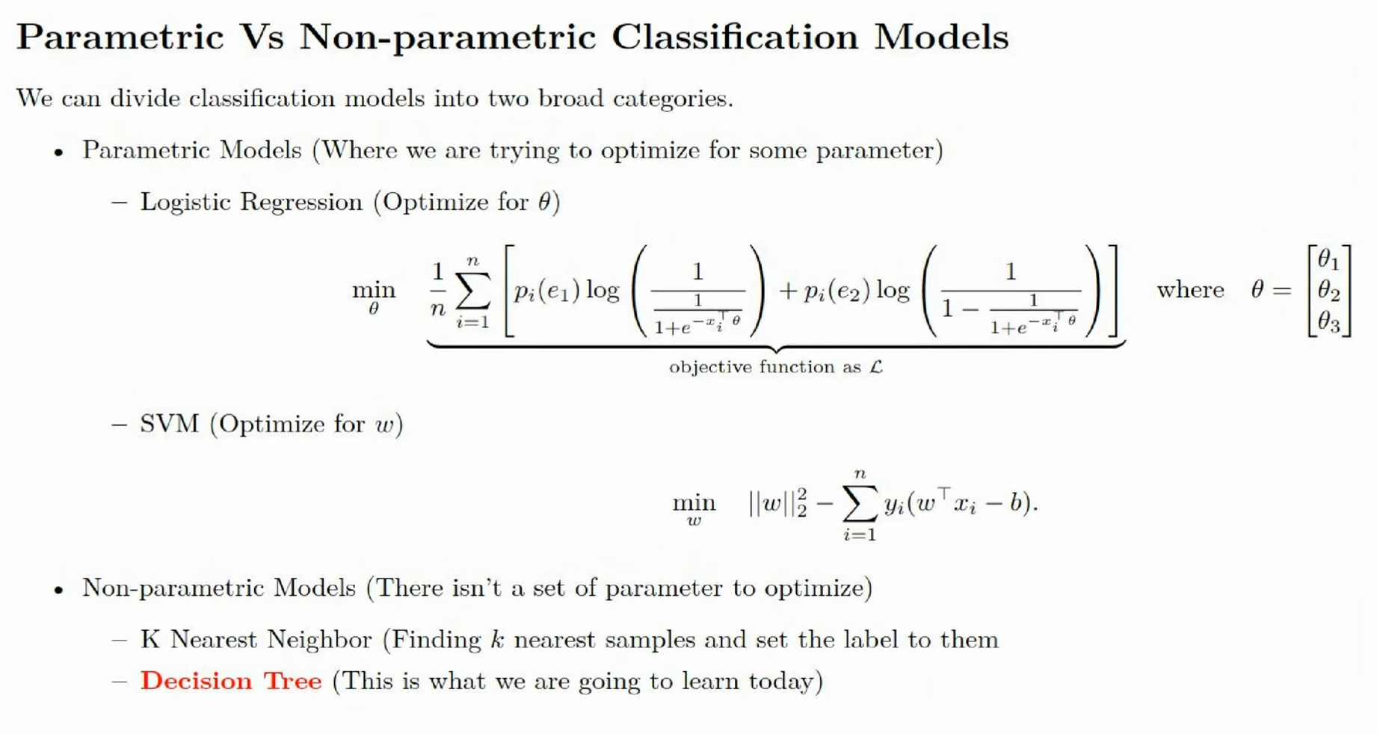

Slide 5
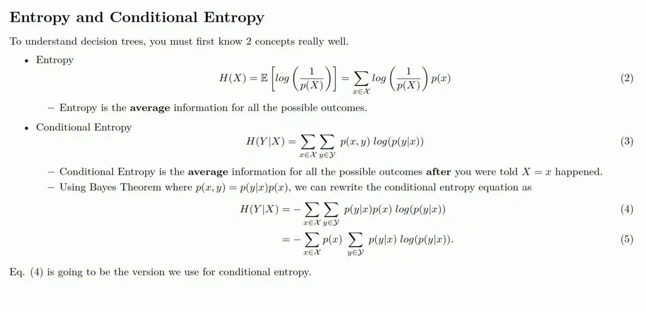

Slide 6
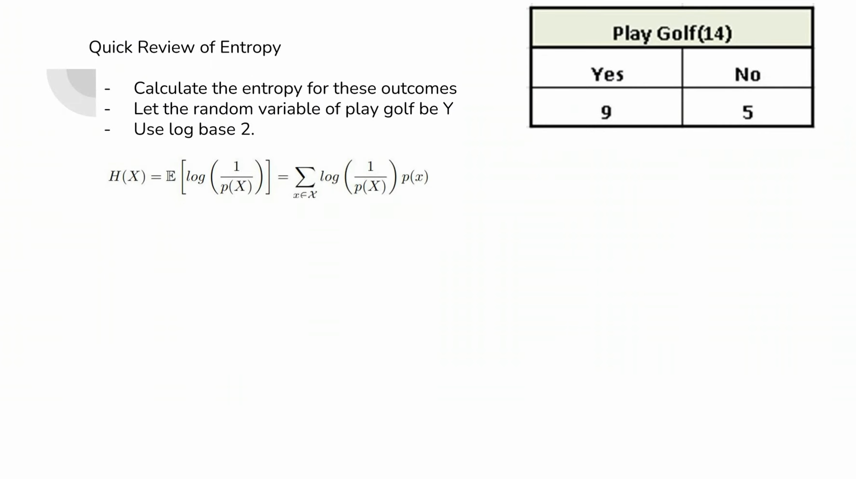

Slide 7
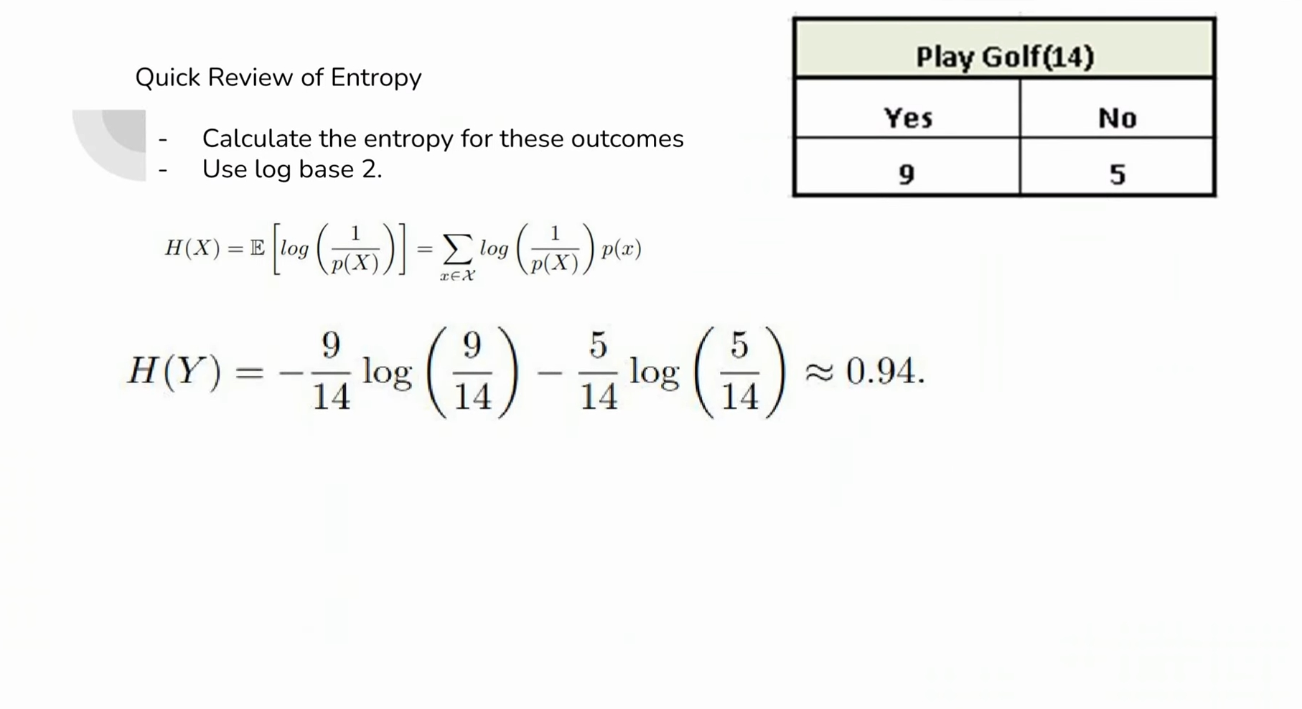

Slide 8
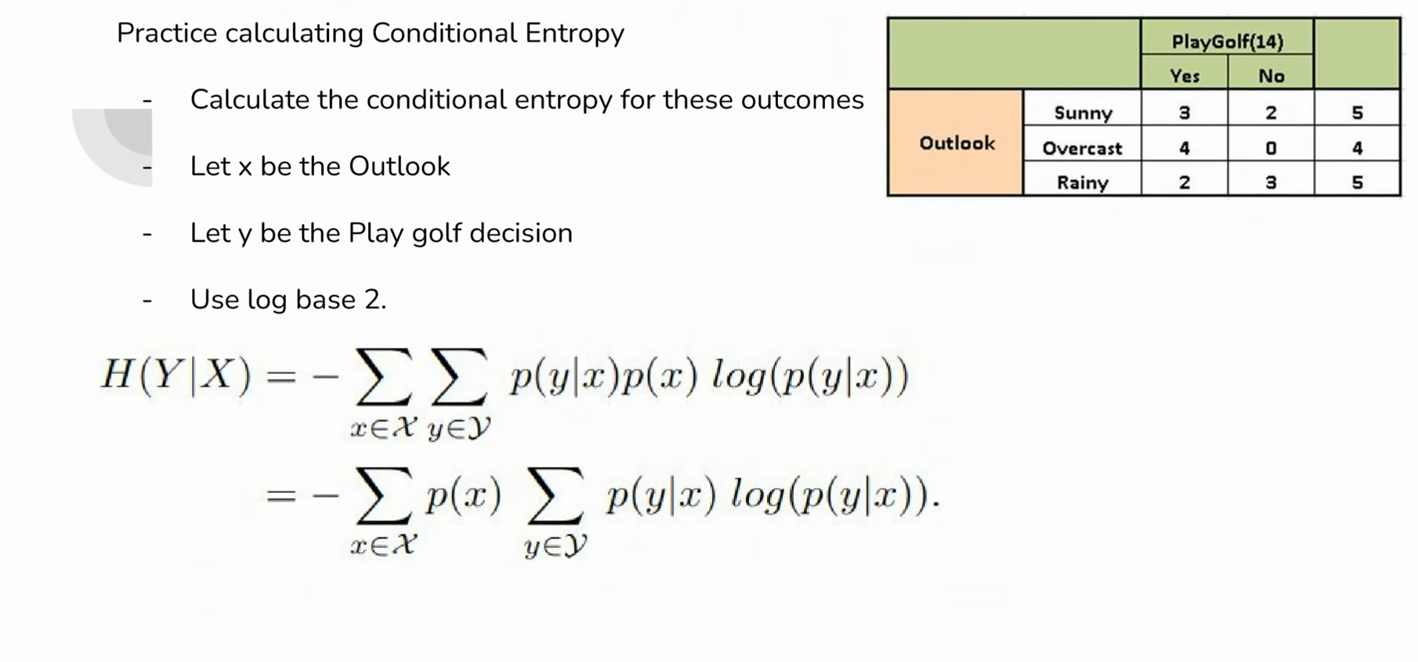

Slide 9
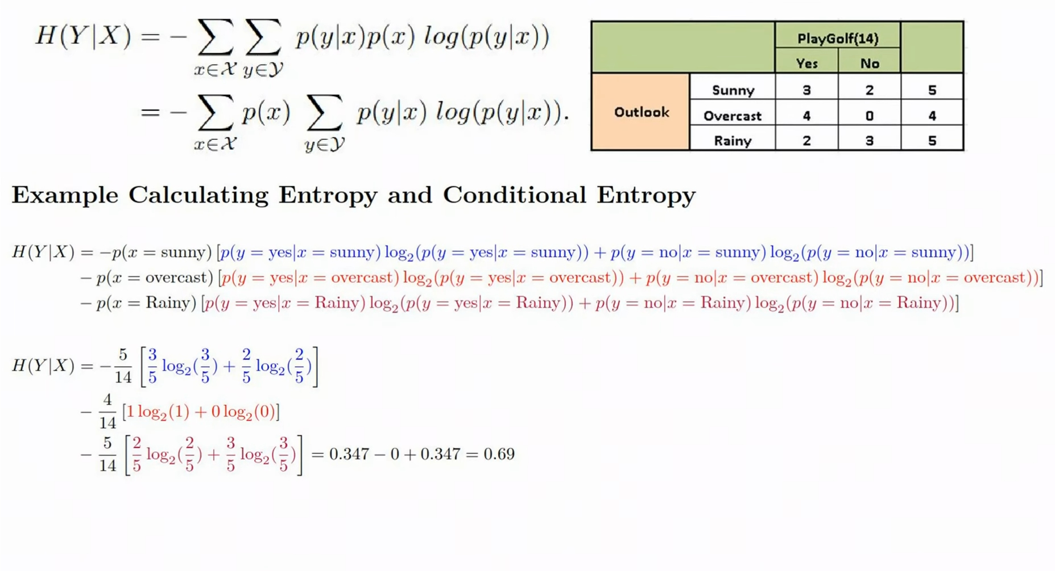

Slide 10
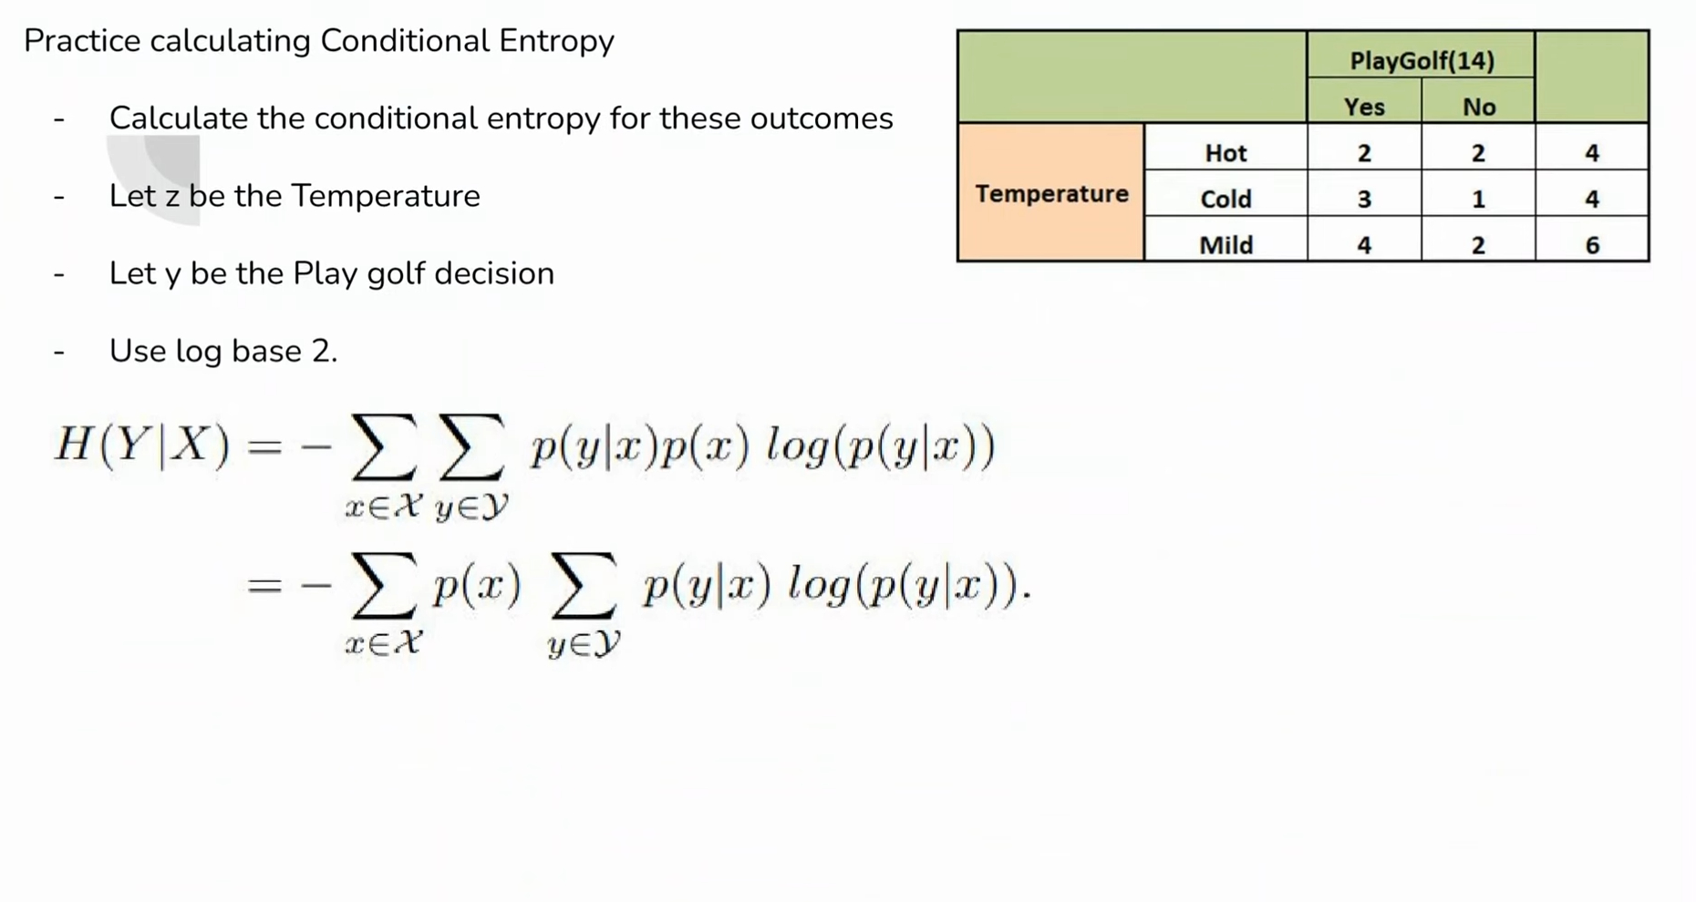

Slide 11
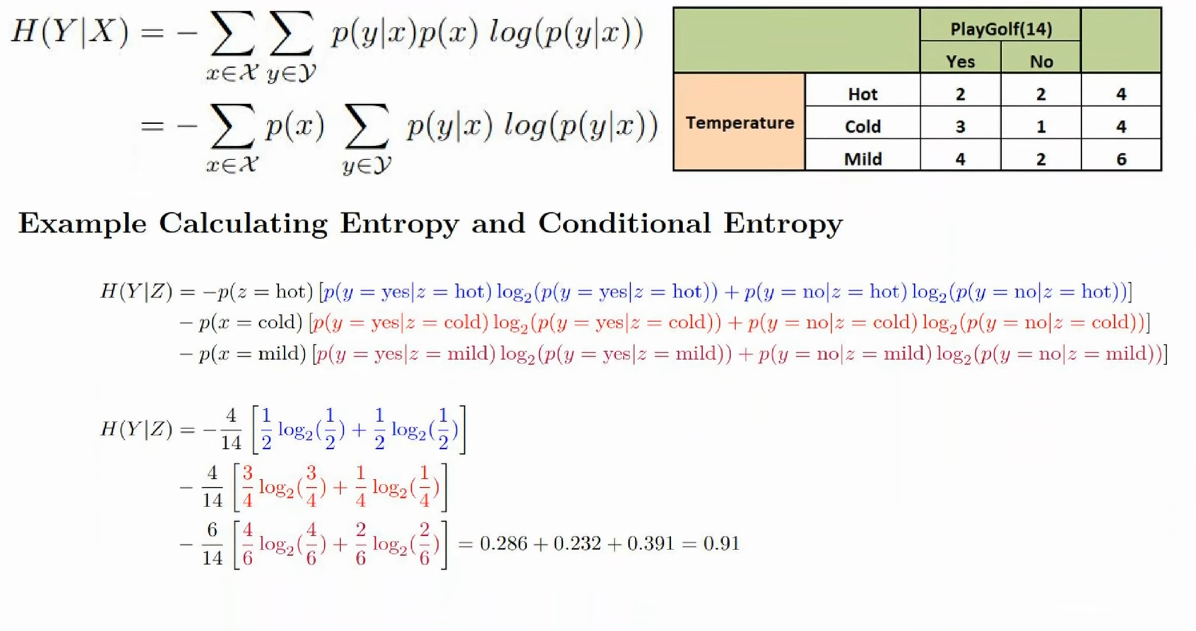

Slide 12
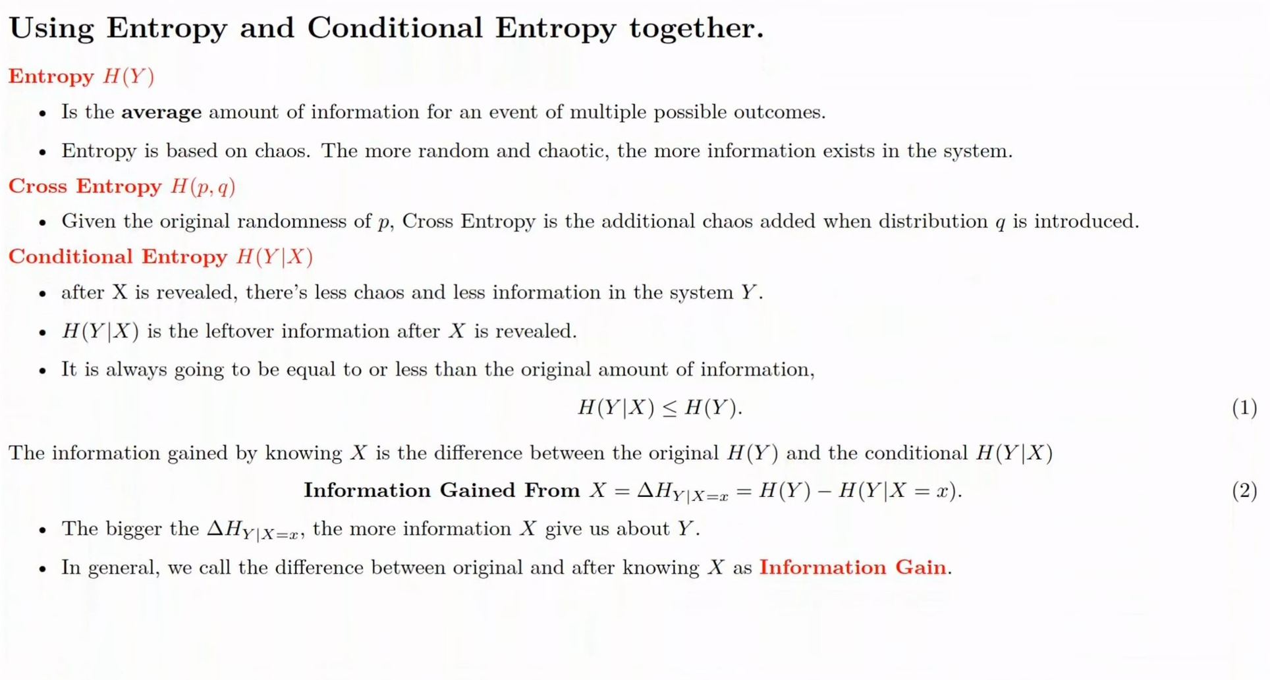

Slide 13
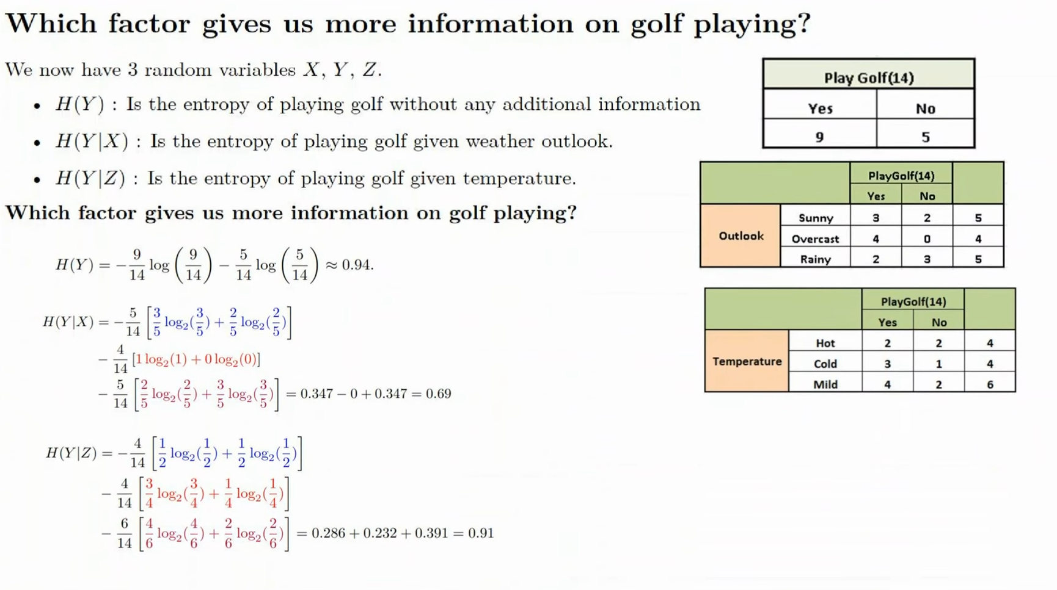

Slide 14
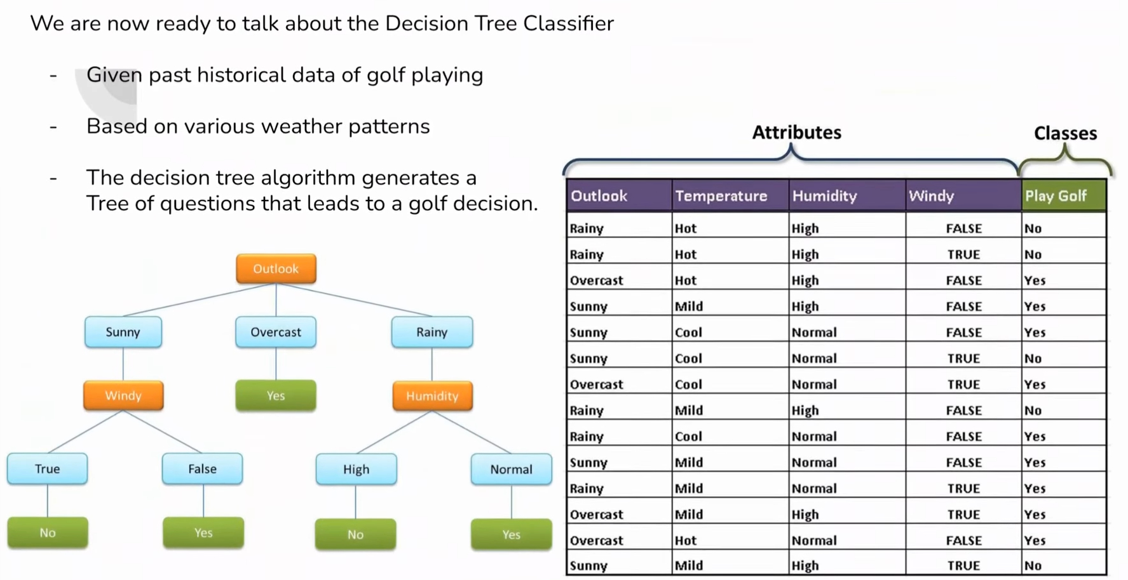

Slide 15
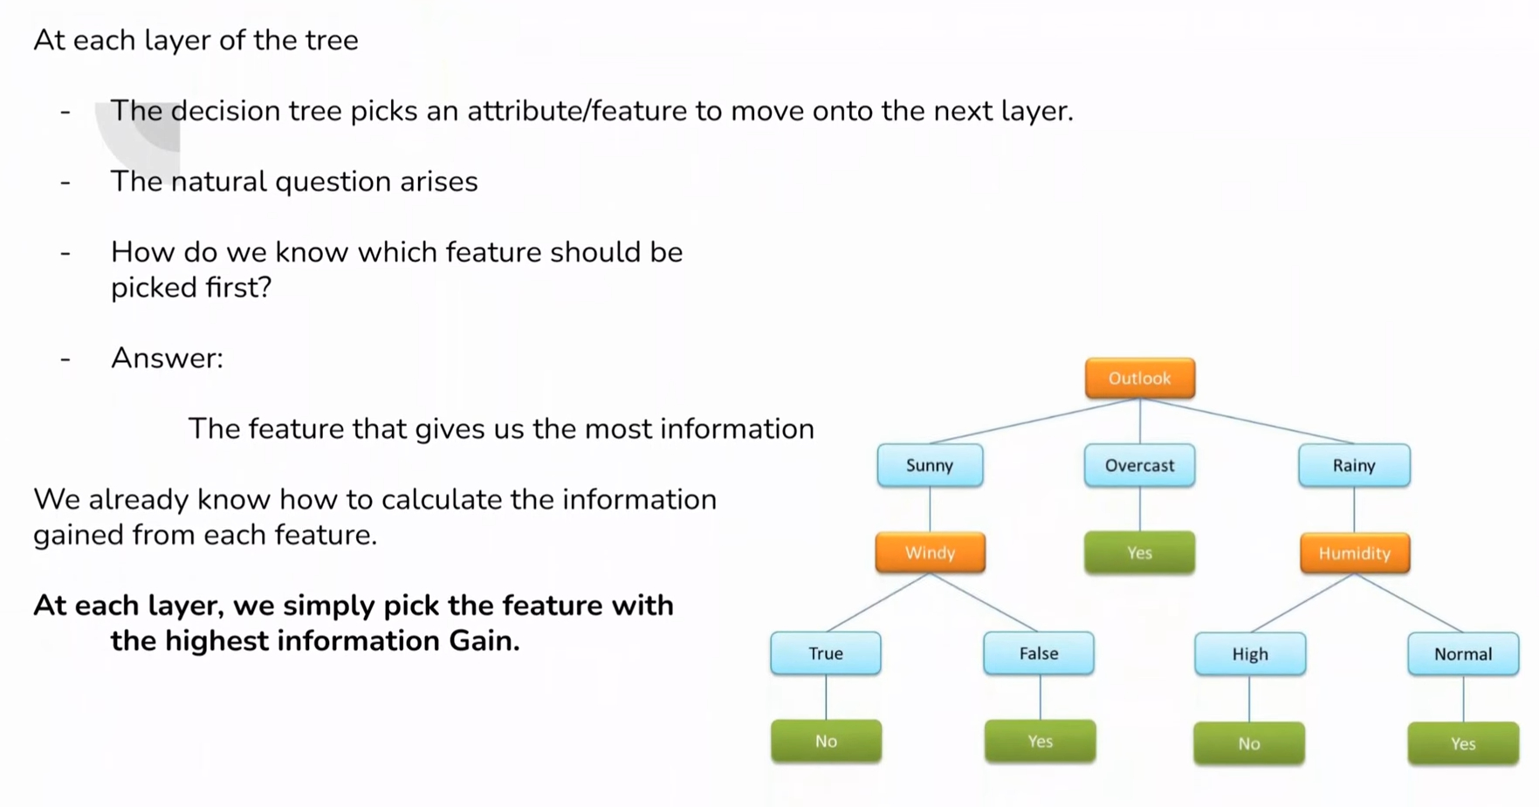

Slide 16
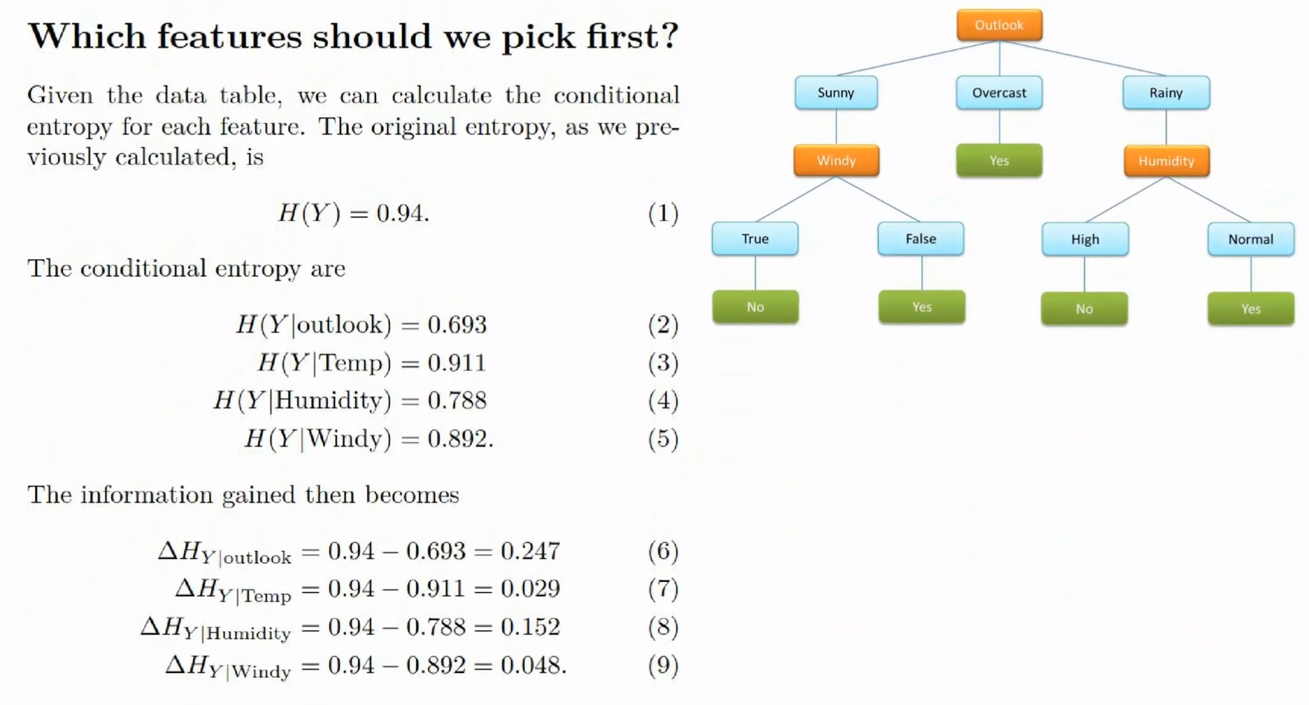

Slide 17
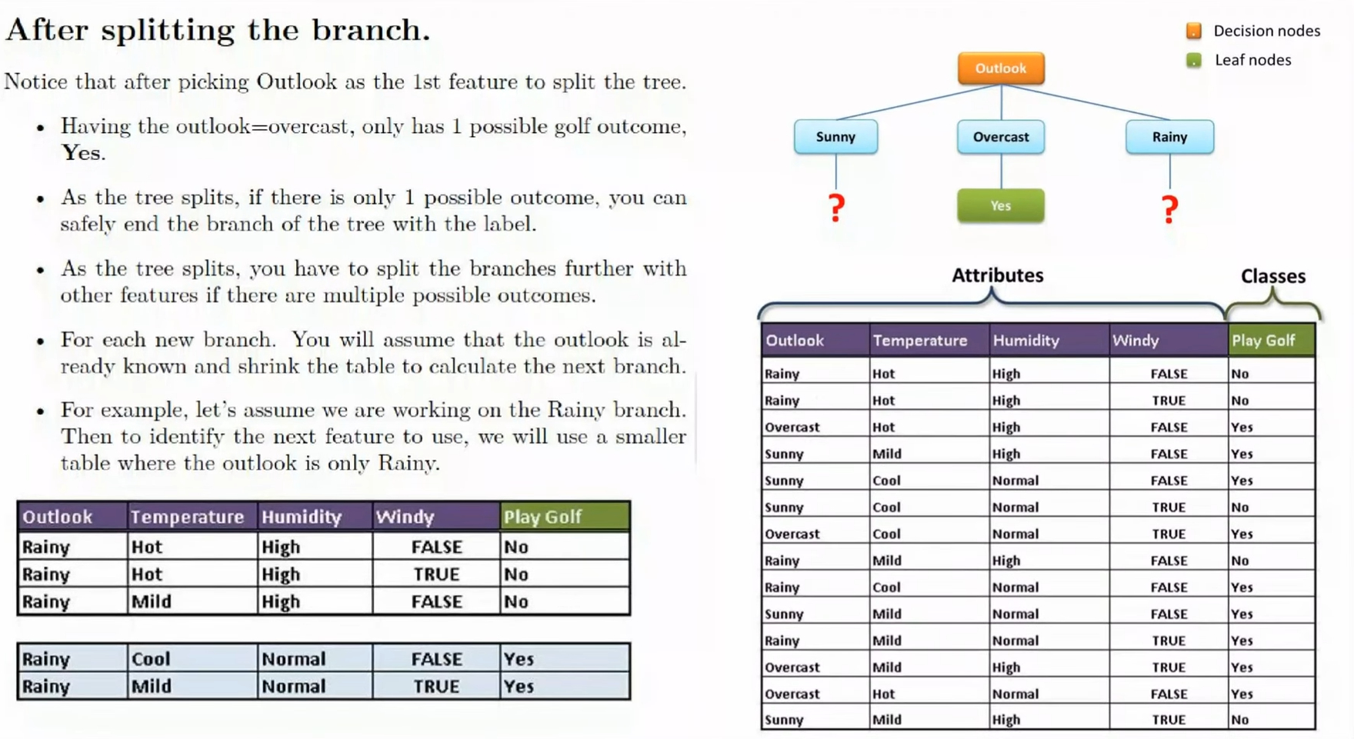

Slide 18
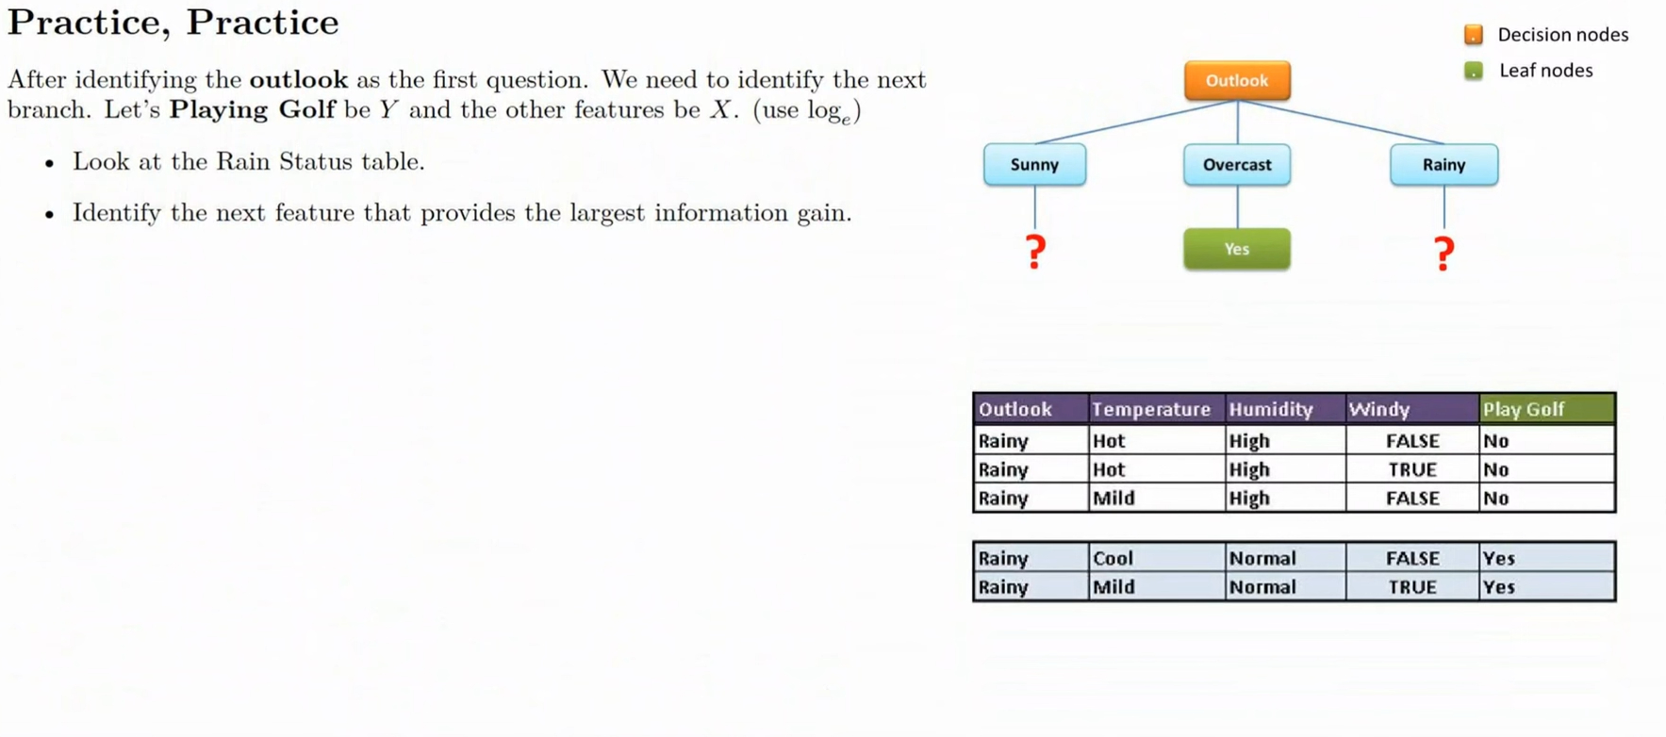

Slide 19
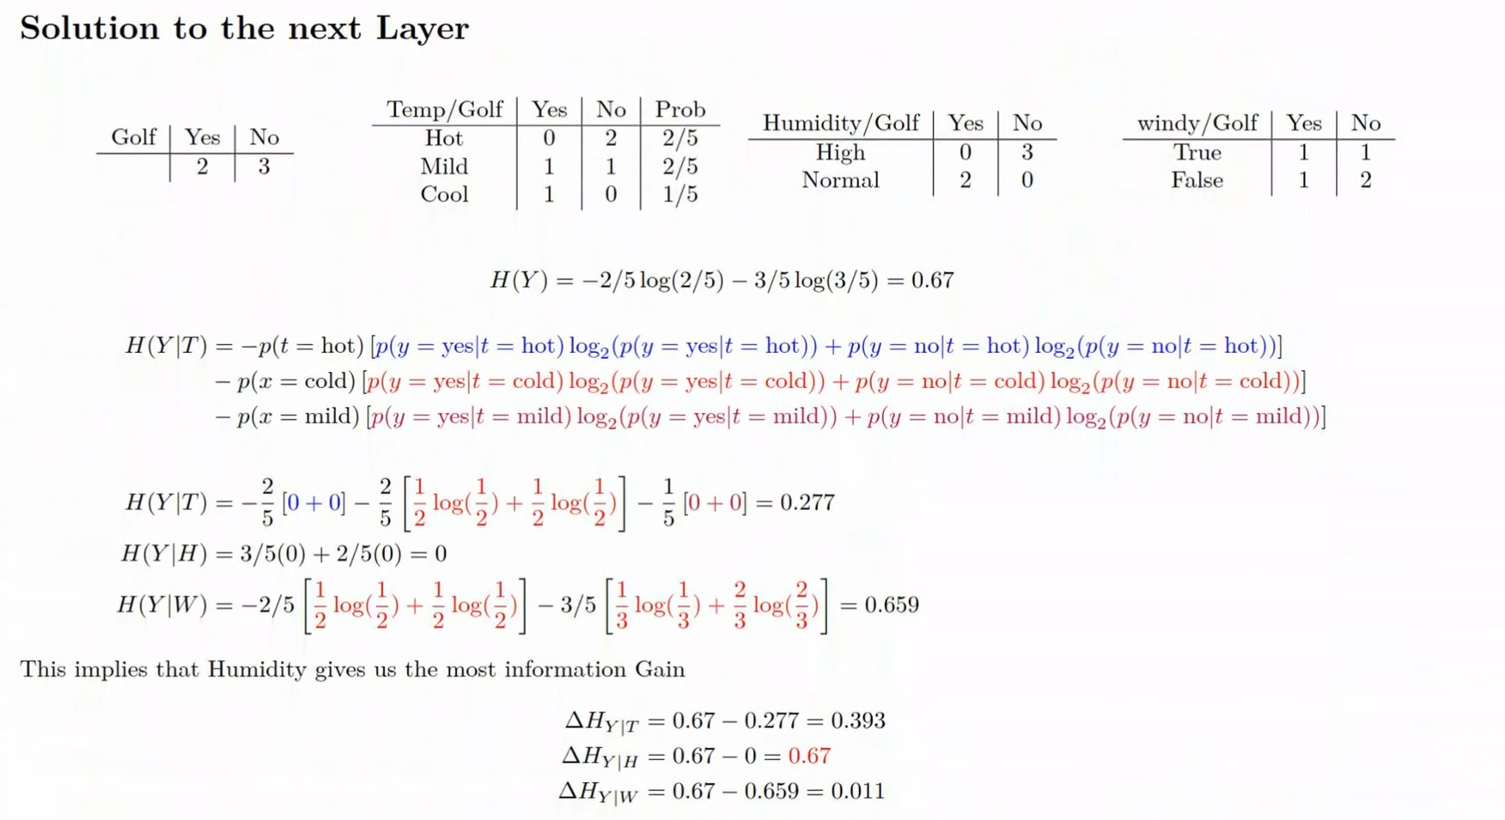

Slide 20
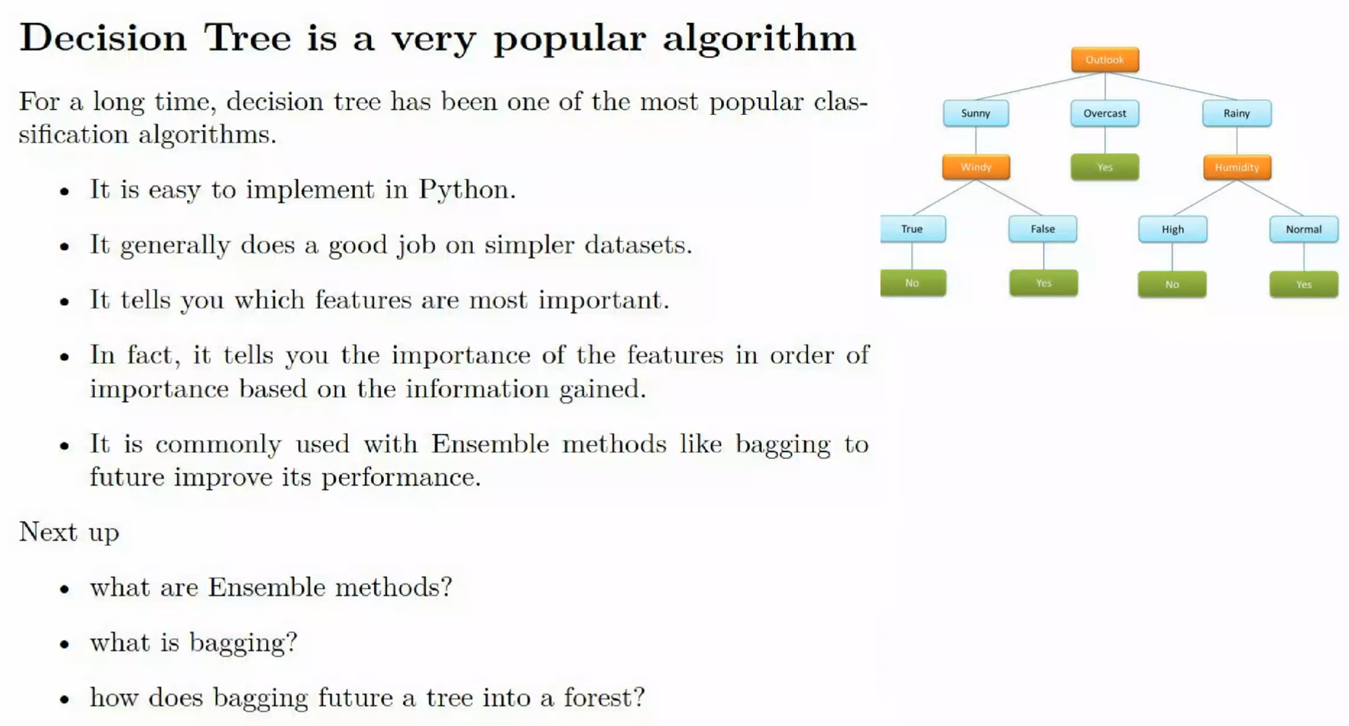

Slide 21
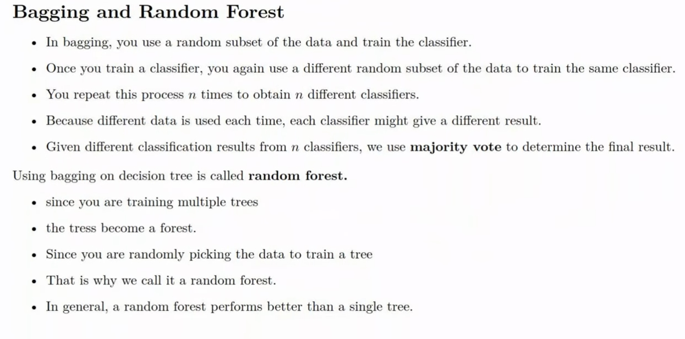

Slide 22
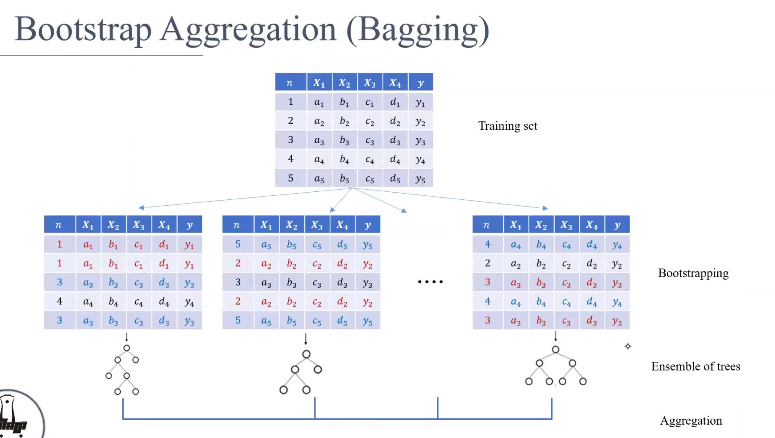
https://www.youtube.com/watch?v=AategB38Zqc

Slide 23
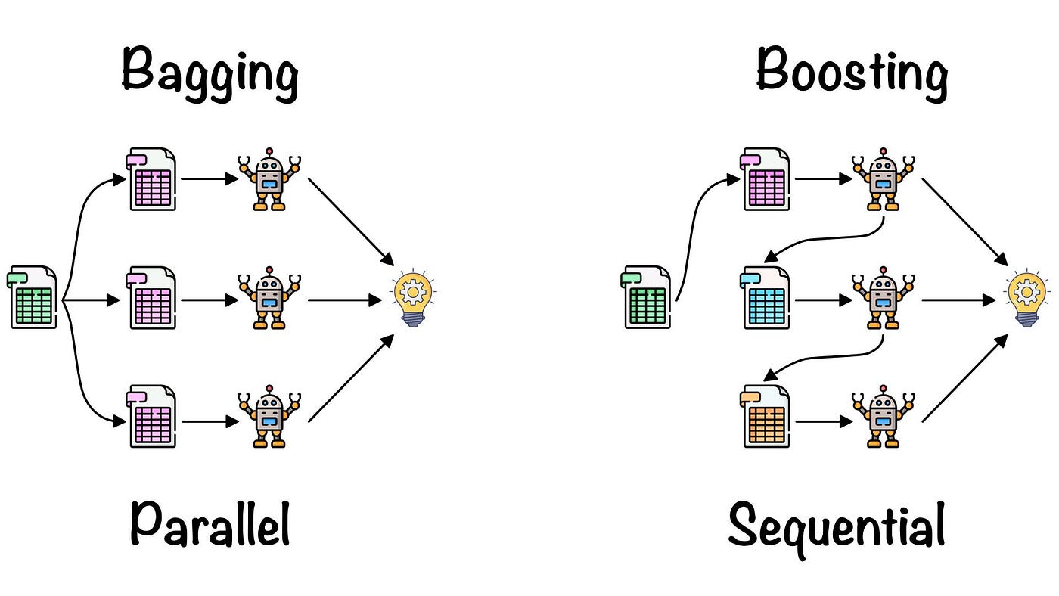
https://medium.com/@roshmitadey/bagging-v-s-boosting-be765c970fd1

Slide 24
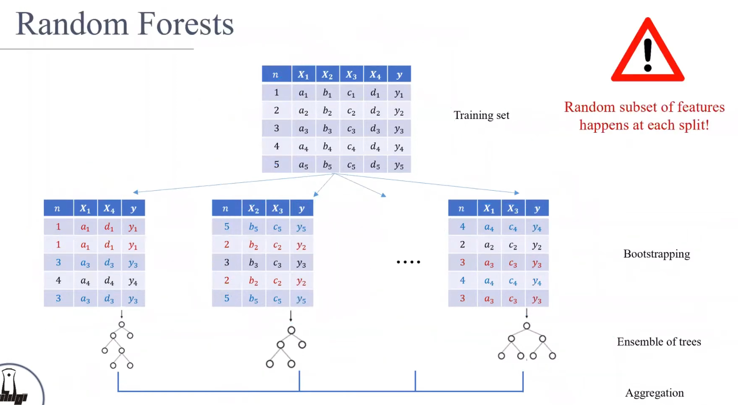

Slide 25
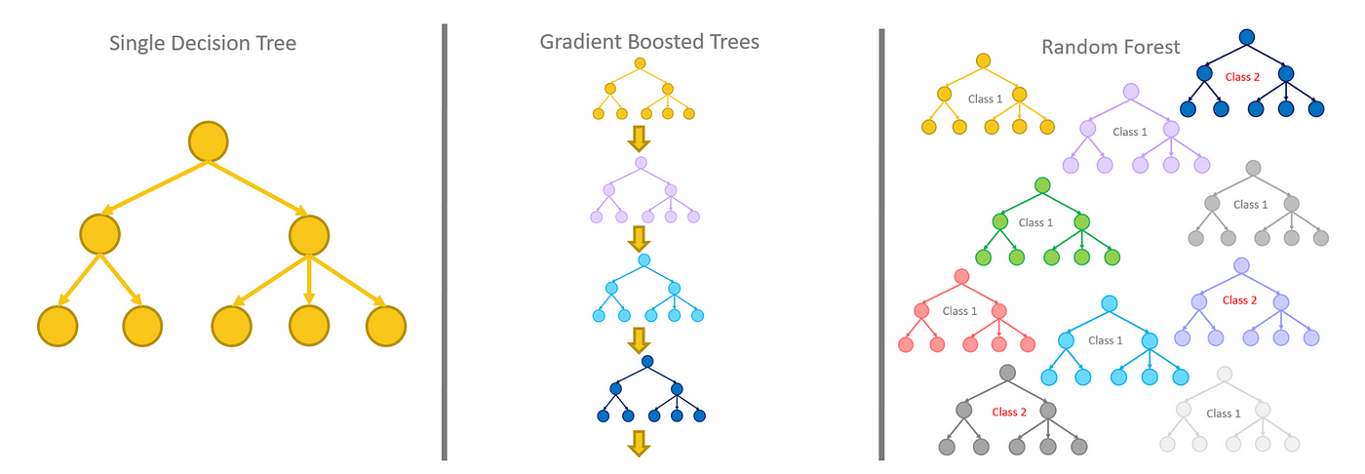
https://medium.com/analytics-vidhya/ensemble-models-bagging-boosting-c33706db0b0b

Slide 26
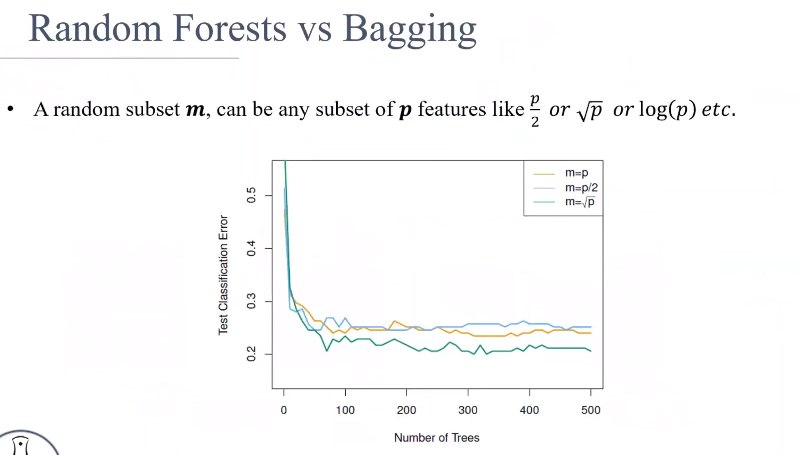

Slide 27
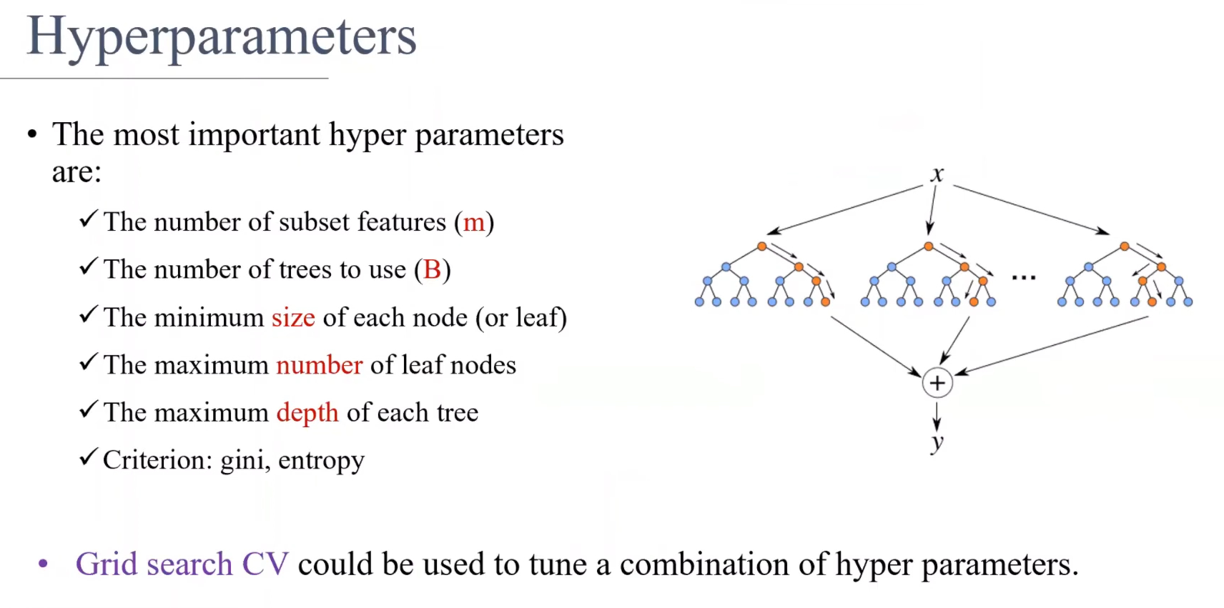

Slide 28
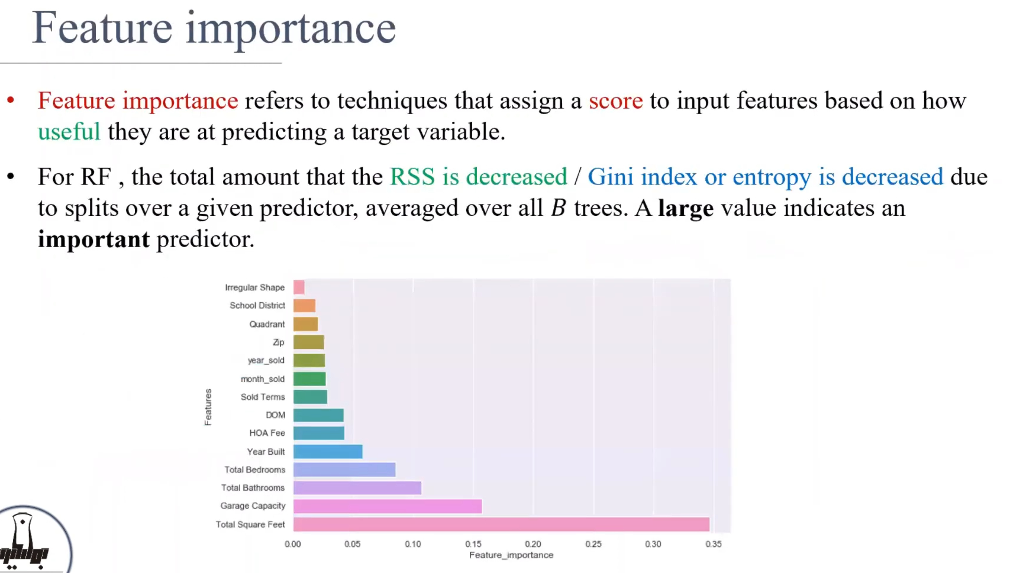

Slide 29

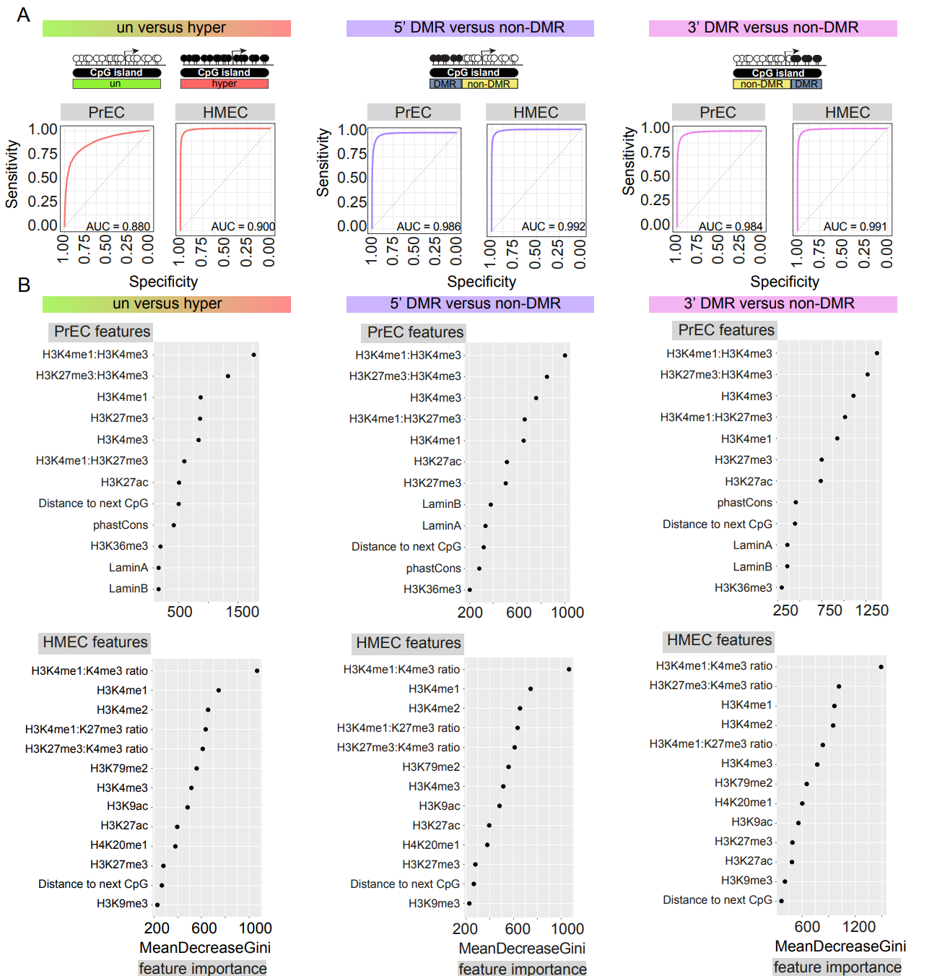

Slide 30
Hands-on Exercises
Decision Tree
https://www.geeksforgeeks.org/decision-tree-introduction-example/
Apply the decision on the prostate cancer methylation data
Random Forest and Feature Importance
https://inria.github.io/scikit-learn-mooc/python_scripts/dev_features_importance.html
https://www.kaggle.com/code/pratikkgandhi/predicting-breast-cancer-with-random-forest-95

Slide 31
Thanks for your attention!
Giảng viên: TS. Lưu Phúc Lợi
Luu.p.loi@googlemail.com
Zalo: 0901802182

